Slide 1


Plant Language Translator
IOE Lab Project
Supervisor Prof. V. E. Pawar.
.

Slide 2
Team Members
08 Yash Prashant Bodhe
10 Arpita Ananda Chavan
12 Pushkraj Nitin Dhamale
19 Rohit Ramesh Gupta

Slide 3
Introduction
The "Plant Language Translator" project is an ambitious undertaking that seeks to merge the realms of science, technology, and nature by harnessing the power of Arduino Uno microcontrollers, environmental sensors, and a Python-based graphical user interface.
The "Plant Language Translator" project takes on the challenge of deciphering these signals and translating them into human-readable messages.
This amalgamation of technology and nature facilitates more informed care for our green companions, transcending traditional care practices.

Slide 4
Literature Review
1) "Worldwide Auto-mobi: Arduino IoT Home Automation System for IR Devices" by Ayad Ghany Ismaeel and Mohammed Qasim Kamal
2) "DIY Smart Home IR Blaster with ESP8266" by Anurag Chugh
3) "Arduino IR Remote Control" by Dejan Nedelkovski
4) "DIY IR Remote Control for Home Appliances with ESP8266“
5) "Design and Implementation of an Infrared Communication System using Arduino" by Aditi Chaurasia and Jatin Agrawal.

Slide 5
Objectives of Work
The objectives of the project are:
Map Different reading from sensors with valid messages.
Interfacing arduino with python.

Slide 6
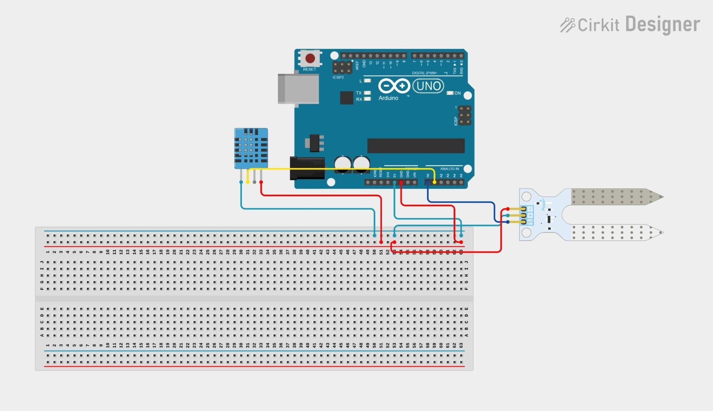
Models / Block Diagram

Slide 7
System Requirements
SR. No | Components | Quantity
1 | Arduino Uno | 1
2 | DHT11 | 1
3 | Soil moisture sensor | 1
4 | USB Type B Cable | 1
5 | Jumper Wires | 9
6 | Desktop / Laptop | 1
7 | Breadboard | 1

Slide 8
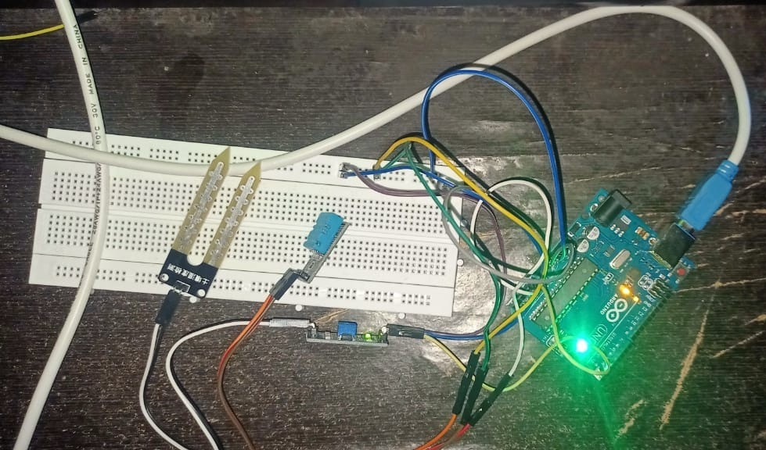
Results and Analysis

Slide 9
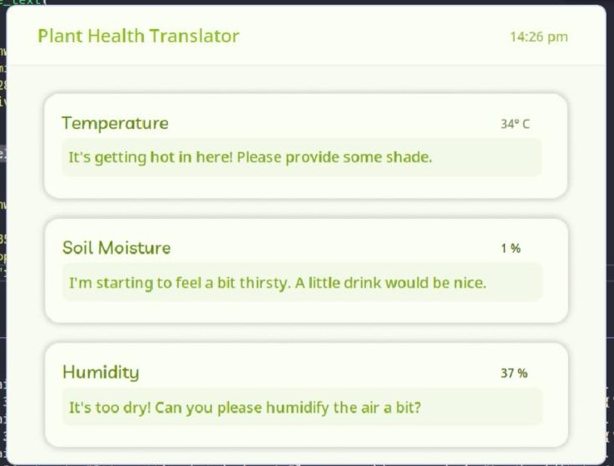
Results and Analysis

Slide 10
Conclusion
By deciphering the language of plants, we can gain valuable insights into their needs, stressors, and interactions with the environment, enabling us to respond more effectively to challenges such as climate change, biodiversity loss, and food security.

Slide 11
Thank You !

